Slide 1


ERD for Daikin Industries
Industry Visit Project at Daikin Industries. Objective: Create an Entity Relationship Diagram (ERD) for Daikin Industries, to improve modeling key business processes and data flow.
Notes:
1

Slide 2
Problem Statement
Data Flow Challenges
ERD Design
Goal
Understanding Daikin's operations and data management.
Accurately reflect data flow, including order processing and inventory.
Identifying data relationships and streamlining operational efficiency.
Notes:
2

Slide 3

Data and Analysis
Orders, Customers, Payments, Shipments
Products, Inventory, Warehouses
Suppliers and Supplier Orders
Employees, Departments, Service Technicians
Notes:
3

Slide 4

Key Observations
1
Data Relationships
2
Normalization
Efficient data flow is ensured by comprehensive coverage.
Data redundancy is reduced by proper normalization of entities.
3
Order Processing
Enhanced by clear linkages between orders, products, and inventory.
Notes:
4

Slide 5





Insights and Recommendations
Enhance Efficiency
Minimize data inconsistencies.
Automate Data Entry
Reduce manual errors.
Establish Integrity
Ensure accuracy of data.
Regular Audits
Maintain consistency.
Notes:
5

Slide 6
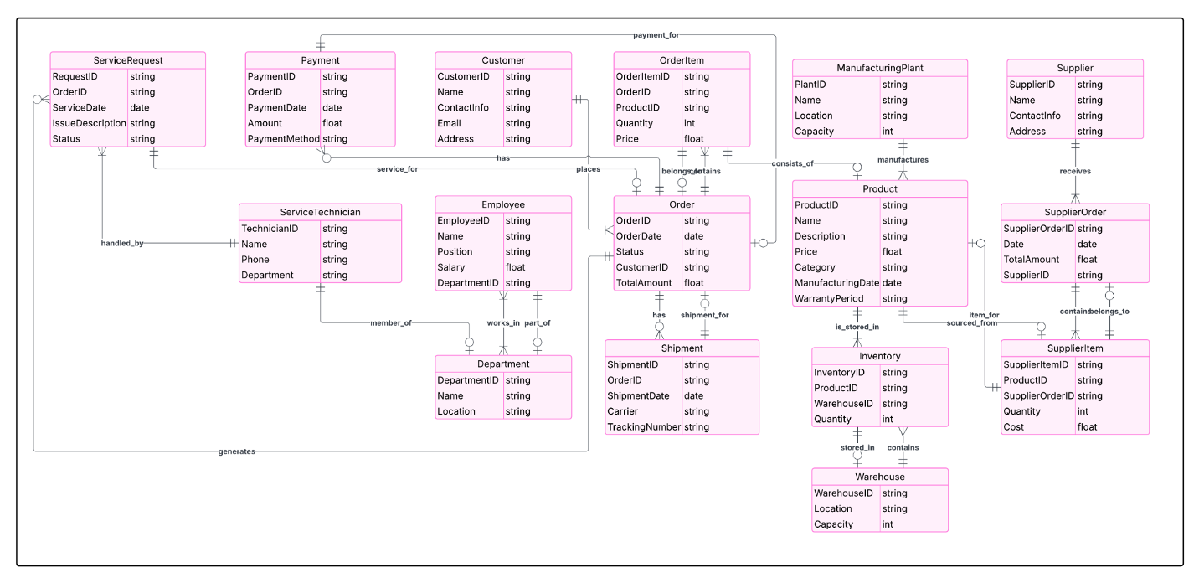
ERD Diagram
Notes:
6

